Slide 1
Efficiency of MSG Trade Facilitation Services TradeCom II Building ACP Trade Capacity: Knowledge Sharing on Trade and Investment “Good Practices” Henry Sanday (h.sanday@msg.int), Trade and Investment Adviser Brussels, Belgium 20-21 February 2018

Slide 2
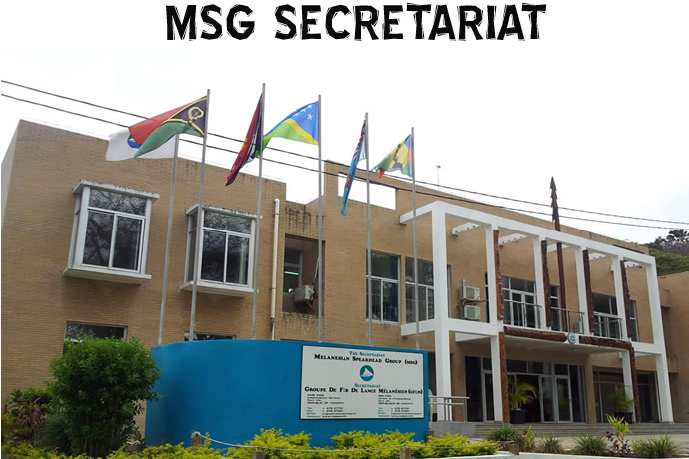
Melanesian Spearhead Group (MSG)
Genesis: Political desire for decolonization and freedom, thus a stronger cultural, political, social and economic identity and link in Melanesia
Established: 1988; Members: Fiji, PNG, Solomon Islands, Vanuatu & FLNKS
Associate Member: Indonesia (representing 5 Melanesian Provinces)
Observers: Timor-Leste and United Liberation Movement for West Papua (ULMWP)
Secretariat: Port Vila, Vanuatu; Staff: 12 Professional & 10 Administrative/Support
Structure: Executive, Governance & Political Affairs, Sustainable Development, Economic Development, Trade & Investment; and, Corporate Services
PNG
MSG Secretariat
Solomon Islands
Vanuatu
FLNKS
Fiji
Australia

Slide 3
MSG Trade Agreement: A Snapshot
1993: MSGTA1 in force; positive list approach
Rules of Origin distinguish MSG & non-MSG goods
2005: MSGTA2 signed; negative list approach
Vanuatu & Fiji eliminated tariffs on all MSG goods
PNG & Sol Is to eliminate remaining tariff lines by 2018
2013-16: MSGTA3 negotiations to deepen integration through a comprehensive free trade area for MSG
Melanesian Free Trade Agreement (MFTA)
Signed: Sol Is (2016) & Fiji (2017); Ratification ongoing
PNG & Vanuatu pending; MFTA implementation 2018???
WTO TFA: Fiji signed; PNG, Sol Is & Vanuatu pending

Slide 4
MSG Trade Facilitation Issues
Generally inefficient: slow, complicated, user unfriendly procedures and systems
Members modernising (Single Window & ASYCUDA)
Doing Business “Trading Across Borders” Rankings
2013 (out of 185): Fiji 111; PNG 120; Sol Is 86; Vanuatu 132
2018 (out of 190): Fiji 75; PNG 137; Sol Is 156; Vanuatu 143
Must enhance efficiency to enable export-led growth and ultimately improve quality of life, as articulated in MSG 2038 Prosperity For All Plan & Members’ NDS
MSG capacity building proposal to TradeCom

Slide 5
Private Sector Perspectives
General aversion: “Benefits for some and not for all”
Lack of awareness of Trade Facilitation themes & reforms
Lack of MSGTA trade data for business planning
Shipping costs translates to High Cost of Doing Business
Unilateral policy shifts without consultations: duty & visa fee exemption vs. (unannounced) imposition
Disconnects: Govt/Private Sector; Intra-Govt; Intra-Private Sector & Minister/Border Official
2017 Fiji/PNG Business Council AGM: Noted 50% drop in trade due to “food biosecurity” issues between Fiji & PNG
Costly infrastructure deficiencies (Ports/Roads connectivity)

Slide 6
Port Vila Harbour, Vanuatu
Notes:
In response to my question, Vanuatu’s Director of Ports said his number one problem is “Berthing priorities”. The port can accommodate just one ship at a time and due to Government’s services/tourism-driven economic policy priority, cruise liners will always be given the first chance to berth. Container ships will have to wait.

Slide 7
Delainavesi Bridge, Suva, Fiji
Notes:
Fiji Industries normally exports 200 containers of cement powder per month to PICs including MSG. However, following technical inspections, the weight restriction for this bridge which connects industrial areas (left) to Suva Port (right) was reduced from 25t to 18t. Containerized cement powder exports to MSG countries weighing 25-30t now had to be halved, taken across, then re-packed at the other end of the bridge prior to shipment.

Slide 8
The Way Forward
(Current) TradeCom II Programme Capacity Building Project
Dimension 1: Strengthening MSG Secretariat’s Trade Division to effectively monitor intra-regional and international trade flows
Dimension 2: Identifying air and shipping connectivity bottlenecks and recommending suitable Trade Facilitation improvements
Dimension 3: Improving access to trade-related tools and information
Validation Workshop in Port Vila on 15 Mar 2018
Training & 4 proposals (1 IOM-approved & 1 joint with PIFS)
Customs & Biosecurity Issues: OCO, EDF11, Single Window
Trade Agreement Data Issues: MSG/SPC/PIFS/OCO Regional Trade Statistics Workshop in Suva on 26 Feb-02 Mar 2018

Slide 9
Vinaka vakalevu
Tank tu mas
Tank yu tru
Oleti
Thank you & Merci

